Slide 1


Cross-Cultural Differences

Slide 2


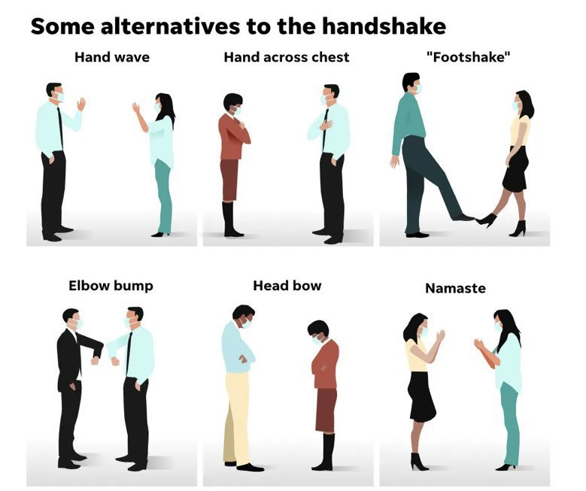
Greetings
casual or formal
cultural differences in street greetings

Slide 3
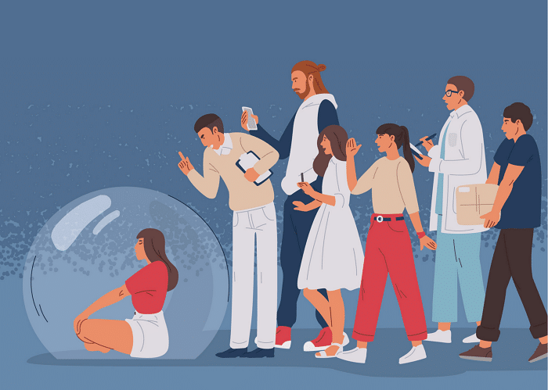
Personal space
Tactile vs. reserved interaction
Interpreting Personal Space Norms
Tactile or 'Touchy-Feely' Cultures

Slide 4
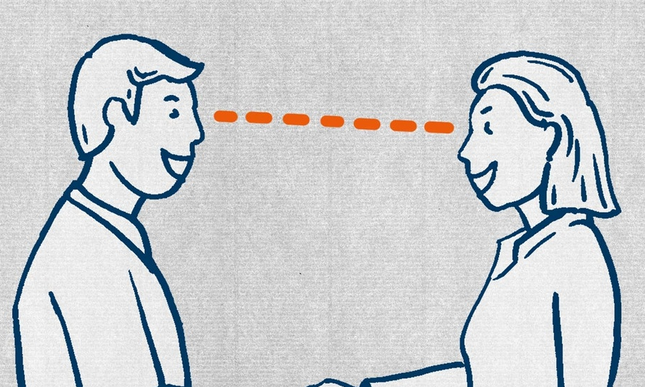
Eye contact
Different Interpretation:
agressive or interested
Role of Gender:
In some countries men and women may avoid direct eye contact out of respect

Slide 5
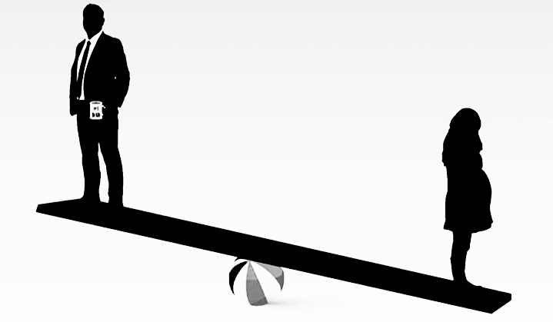
Private sphere vs Public sphere
Boundaries in the workplace and friendships
Flexible vs. clear-cut distinctions
Sharing Personal Information

Slide 6
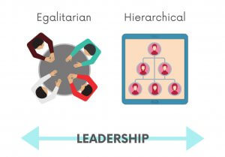
Egalitarian vs. Hierarchical
Deference to higher social status in some cultures
Treating everyone equally in others

Slide 7
Thanks for your attention

